Slide 1
Morphological Image Processing
The word morphology commonly denotes a branch of biology that deals with the form and structure of animals and plants.
We use mathematical morphology as a tool for extracting image components that are useful in the representation and description of region shape, such as boundaries, skeletons, and the convex hull.
The language of mathematical morphology is set theory.

Slide 2
Morphological Image Processing

Slide 3
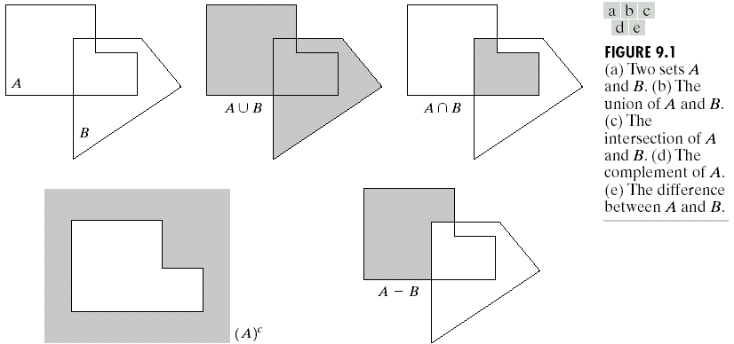
Chapter 9
Morphological Image Processing

Slide 4
Morphological Image Processing

Slide 5
Morphological Image Processing
Logic Operations Involving Binary Images
The principal logic operations used in image processing are AND, OR, and NOT(COMPLEMENT).
Their properties are summarized in the following table-

Slide 6
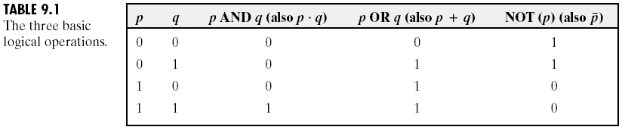
Chapter 9
Morphological Image Processing

Slide 7
Morphological Image Processing
Logic Operations Involving Binary Images
Logic operations are performed on a pixel by pixel basis between corresponding pixels of two or more images (except NOT, which operates on the pixels of a single image).
The following figure shows various examples of logic operations involving images, where black indicates a binary 1 and white indicates a 0.

Slide 8
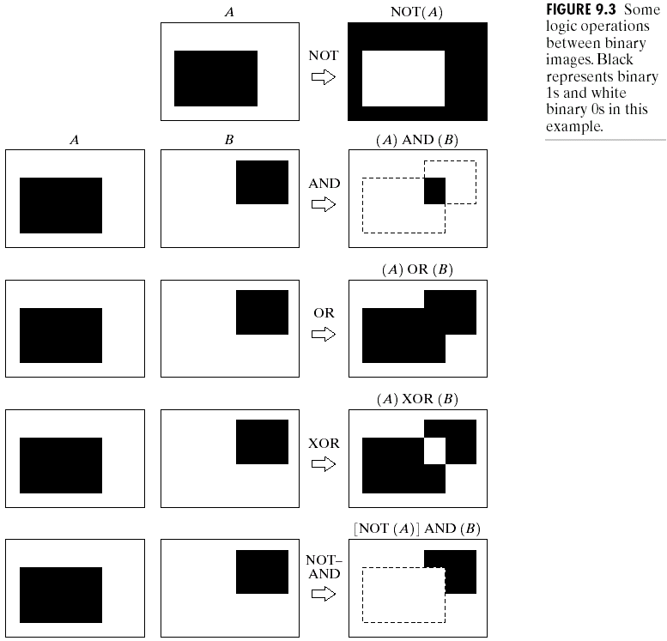
Morphological Image Processing

Slide 9
Morphological Image Processing

Slide 10
Morphological Image Processing

Slide 11
Morphological Image Processing

Slide 12
Morphological Image Processing

Slide 13
Morphological Image Processing

Slide 14
Morphological Image Processing
Erosion and Dilation
Two morphological operations including erosion and dilation.
These operations are fundamental to morphological processing.

Slide 15
Morphological Image Processing
Erosion

Slide 16
Morphological Image Processing
Erosion

Slide 17
Morphological Image Processing
Erosion

Slide 18
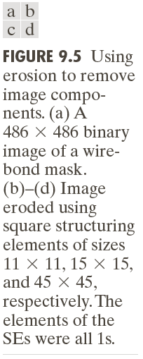
Morphological Image Processing

Slide 19
Morphological Image Processing
Dilation

Slide 20
Morphological Image Processing
Dilation

Slide 21
Morphological Image Processing
Dilation

Slide 22
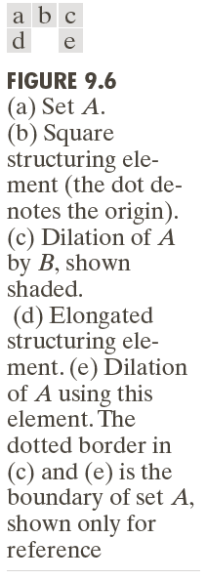
Morphological Image Processing
Dilation

Slide 23
Morphological Image Processing
Dilation

Slide 24
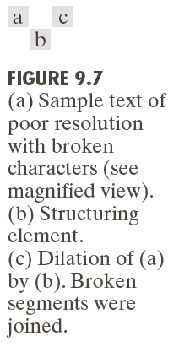
Morphological Image Processing
Example 9.2: An illustration of dilation

Slide 25
Morphological Image Processing
Duality

Slide 26
Morphological Image Processing
Duality

Slide 27
Morphological Image Processing
Duality

Slide 28
Morphological Image Processing
Opening and Closing
As we have seen, dilation expands an image and erosion shrinks it.
Opening generally smoothes the contour of an object, breaks narrow isthmuses, and eliminates thin protrusions.
Closing also tends to smooth sections of contours but, as opposed to opening, it generally fuses narrow breaks and long thin gulfs, eliminates small holes, and fills gaps in the contour.

Slide 29
Morphological Image Processing
Opening and Closing

Slide 30
Morphological Image Processing
Opening and Closing

Slide 31
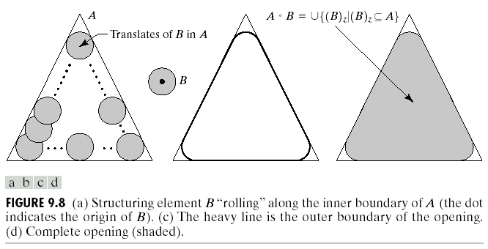
Morphological Image Processing
Opening
The opening operation has a simple geometric interpretation shown in the following figure-

Slide 32
Morphological Image Processing
Opening
We view the structuring element B as a “rolling ball”.
The boundary of A◦B is then established by the points in B that reach the farthest into the boundary of A as B is rolled around the inside of this boundary.
This geometric fitting property of the opening operation leads to a set theoretic formulation, which states that the opening of A by B is obtained by taking the union of all translates of B that fit into A.

Slide 33
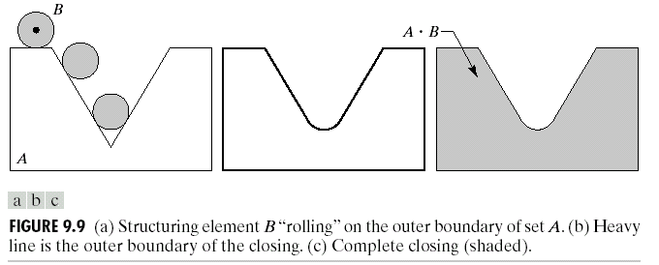
Morphological Image Processing
Closing
Closing has a similar geometric interpretation, except that now we roll B on the outside of the boundary shown in the following figure-

Slide 34
Morphological Image Processing
The following figure illustrates the opening and closing operations.

Slide 35
Morphological Image Processing

Slide 36
Morphological Image Processing

Slide 37
Morphological Image Processing
Morphological operations can be used to construct filters similar in concept to the spatial filters.
The binary image shown in figure 9.11(a) shows a section of a fingerprint corrupted by noise.

Slide 38
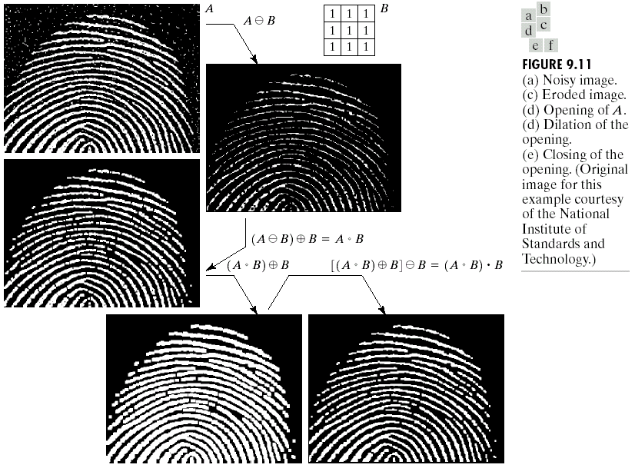
Chapter 9
Morphological Image Processing

Slide 39
Morphological Image Processing
Some Basic Morphological Algorithms
When dealing with binary images, the principal application of morphology is extracting image components that are useful in the representation and description of shape.
Here, we consider morphological algorithms for extracting boundaries, region/hole filling, connected components, the convex hull, the skeleton of a region, Thinning, Thickening and Pruning.

Slide 40
Morphological Image Processing
Boundary Extraction

Slide 41
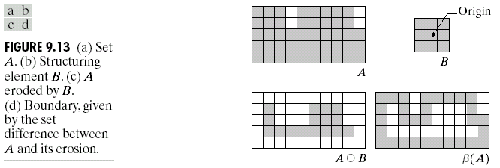
Morphological Image Processing

Slide 42
Morphological Image Processing
Example 9.5: Boundary Extraction

Slide 43
Morphological Image Processing
Example 9.5: Boundary Extraction
In this example, binary 1’s are shown in white and 0’s in black, so the elements of the structuring element, which are 1’s, also are treated as white. Because of the structuring element used, the boundary shown in figure 9.14(b) is one pixel thick.

Slide 44
Morphological Image Processing
Hole Filling

Slide 45
Morphological Image Processing

Slide 46
Morphological Image Processing
Hole Filling

Slide 47
Morphological Image Processing
Example 9.6: Morphological Hole Filling
The following figure 9.16(a) shows an image composed of white circles with black inner spots.
Figure 9.16(a) shows one point selected inside one of the spheres, and figure 9.16(b) shows the result of filling that component.
Figure 9.16 (c ) shows the result of filling all the spheres.

Slide 48
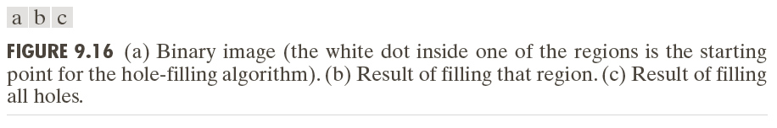
Morphological Image Processing

Slide 49
Morphological Image Processing
Extraction of connected components
Extraction of connected components in a binary image is central to many automated image analysis applications.

Slide 50
Morphological Image Processing
Extraction of connected components

Slide 51
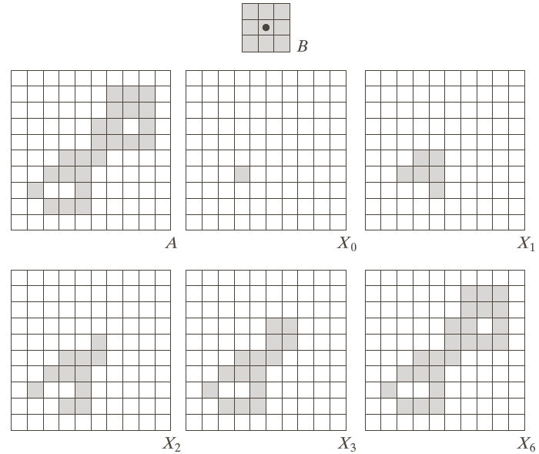
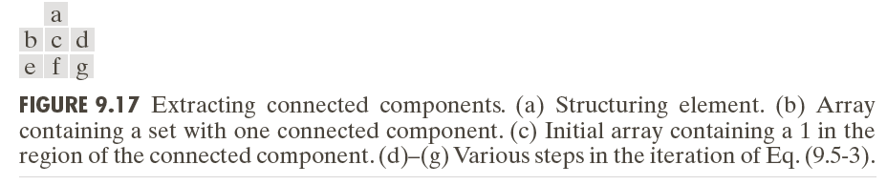
Morphological Image Processing

Slide 52
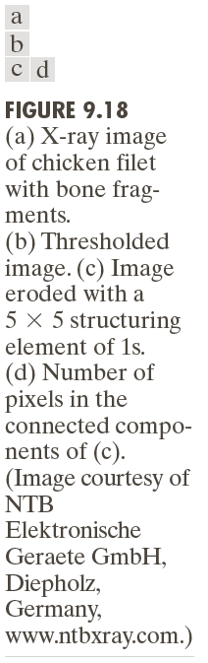
Morphological Image Processing
Example 9.7: using connected components to detect foreign objects in packaged food.

Slide 53
Morphological Image Processing
Example 9.7:

Slide 54
Morphological Image Processing
The Hit-or-Miss Transformation

Slide 55
Morphological Image Processing

Slide 56
Morphological Image Processing
The Hit-or-Miss Transformation

Slide 57
Morphological Image Processing
The Hit-or-Miss Transformation

Slide 58
Morphological Image Processing
The Hit-or-Miss Transformation

Slide 59
Morphological Image Processing
Home work:
Thinning
Pruning

